Slide 1

Flaunt Github Handy Helper
neeravporiya02/Flaunt_For_Git: Flaunt Website for GIt (github.com)

Slide 2
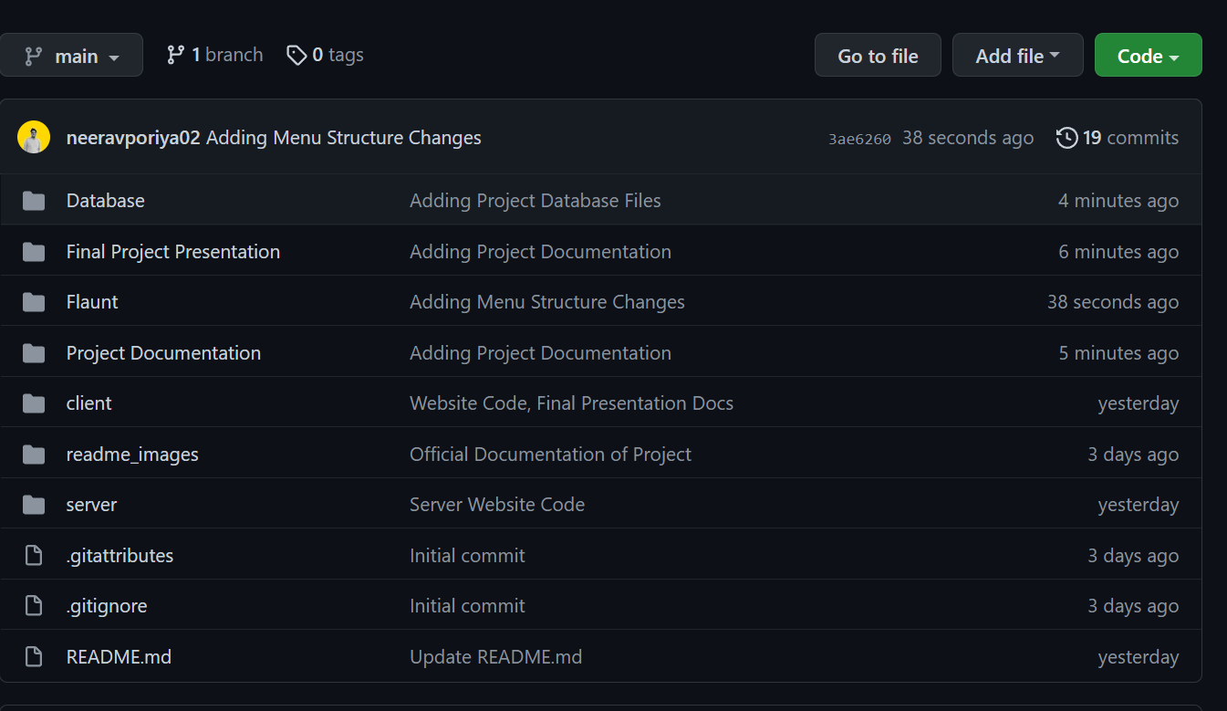
Folder structure for Flaunt Github.

Slide 3
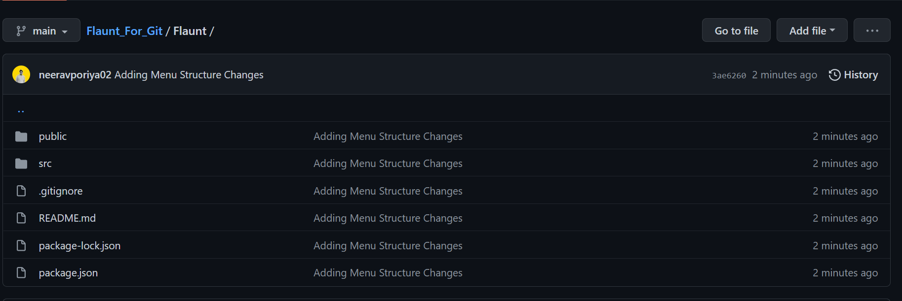
Flaunt Website Structure

Slide 4
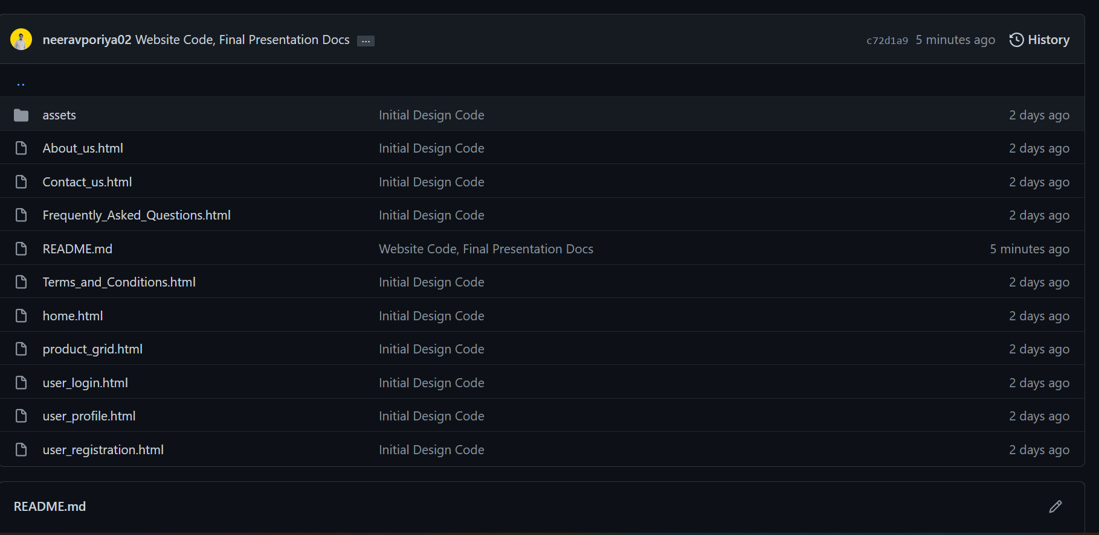
Client folder structure, Here the code files will be populated.

Slide 5
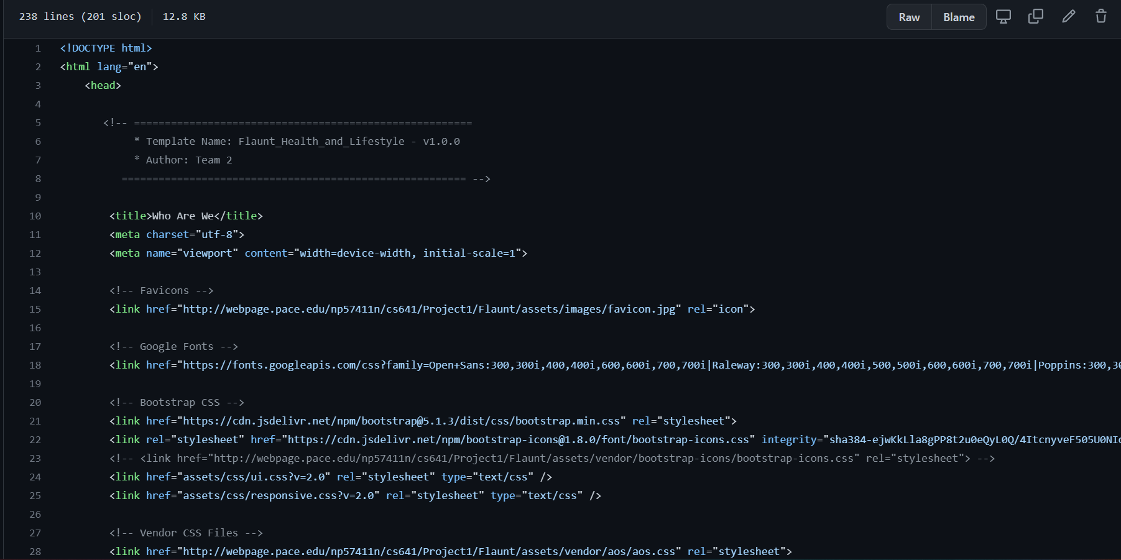
Page code for About_Us page. When user clicks on one of the links inside client folder.

Slide 6
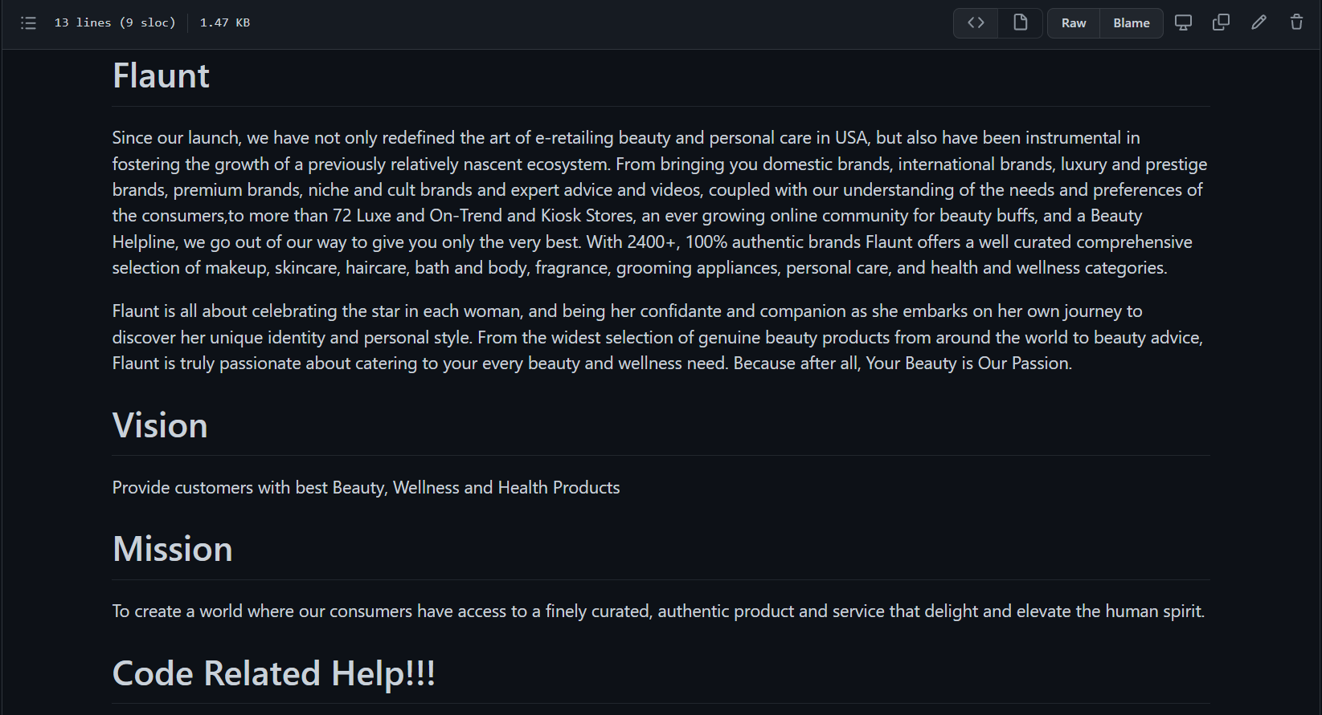

Slide 7
FRONT END

Slide 8
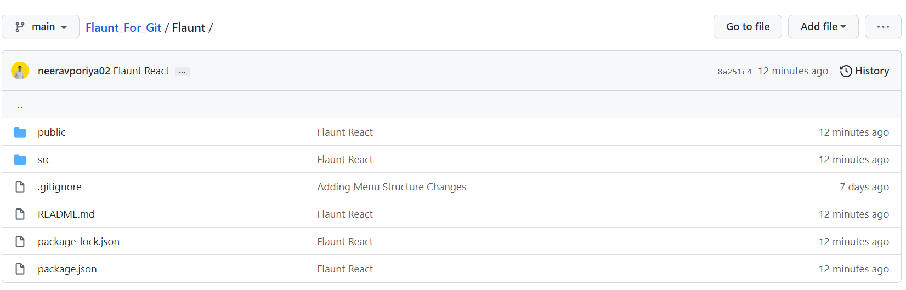
Flaunt Web Applications Frontend Structure

Slide 9
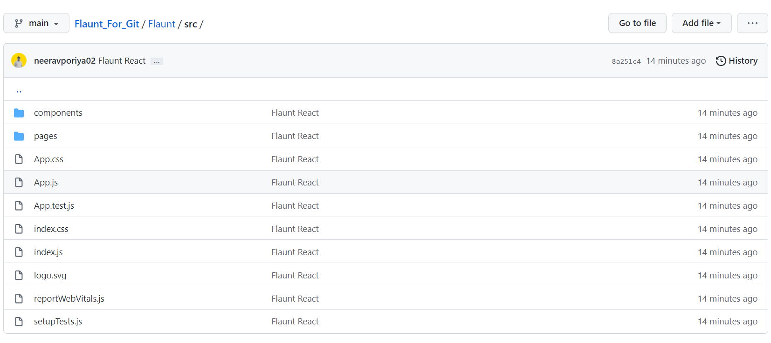
Frontend consists of
Components: It consists of all the common contents of the website like Header, Footer, Page Filters etc.
Pages: Pages consist of all the inner pages of web application like User_Login, User_Registration, User_profile etc.

Slide 10
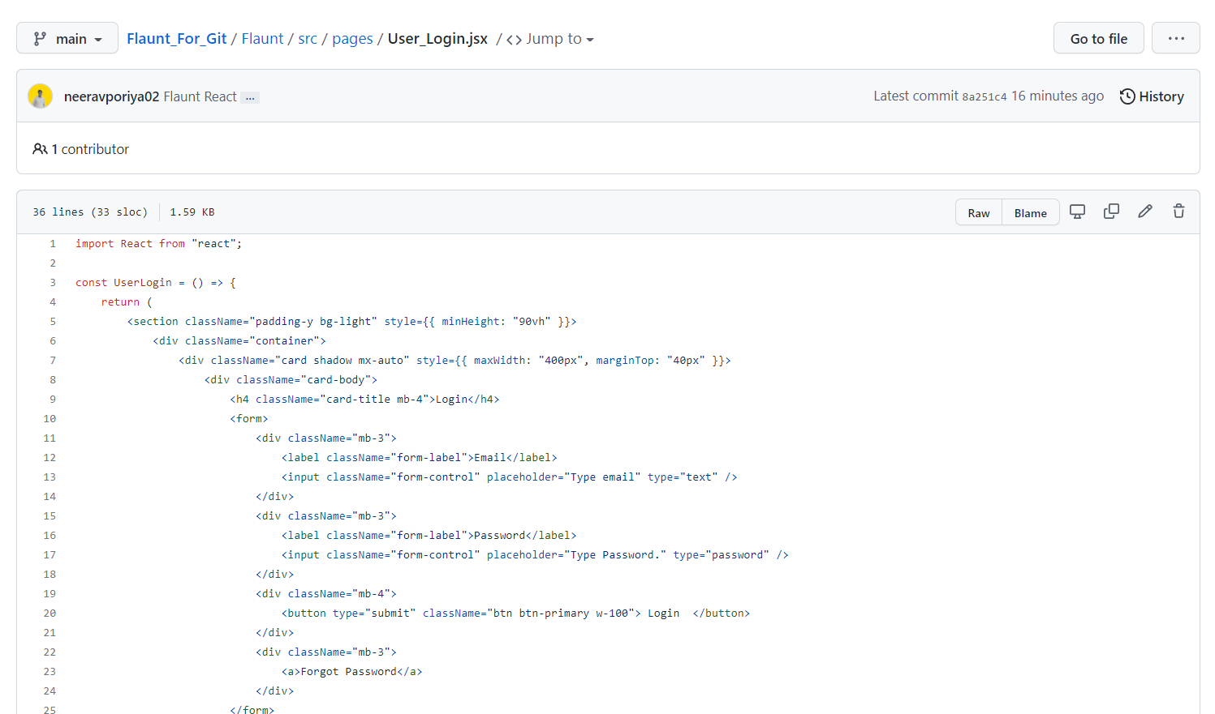
Page Structure
Here we have taken an example of User_Login page structure. From this page it will be linked to an API for Validation, Authentication and backend calls.

Slide 11
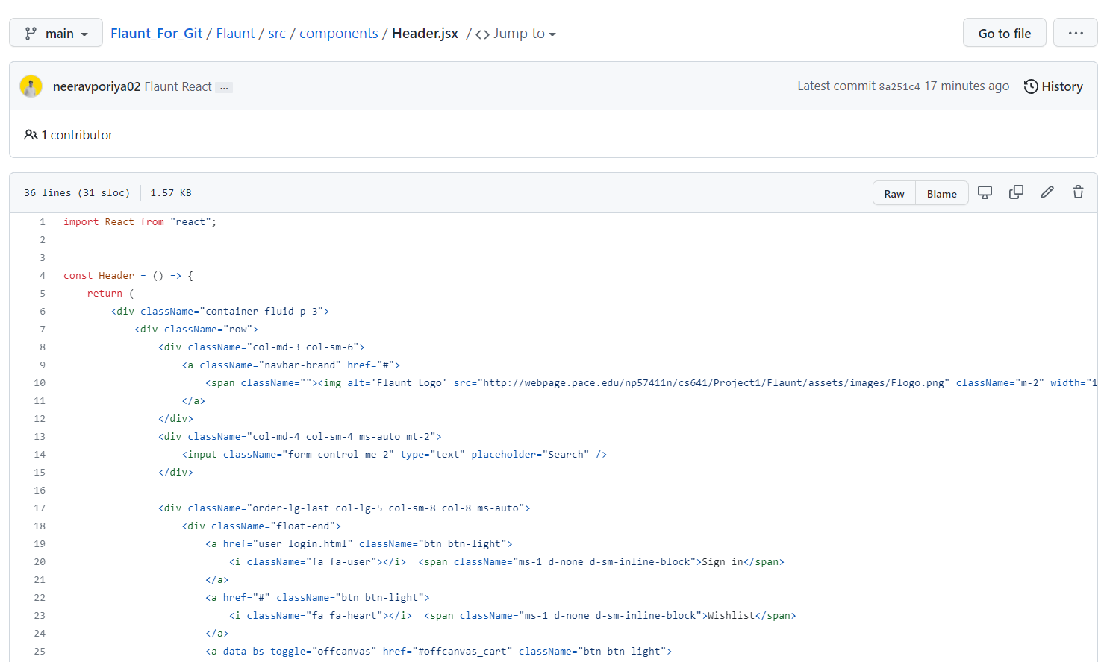
Component Structure
Here we have taken an example of header structure.

Slide 12
BACK END

Slide 13
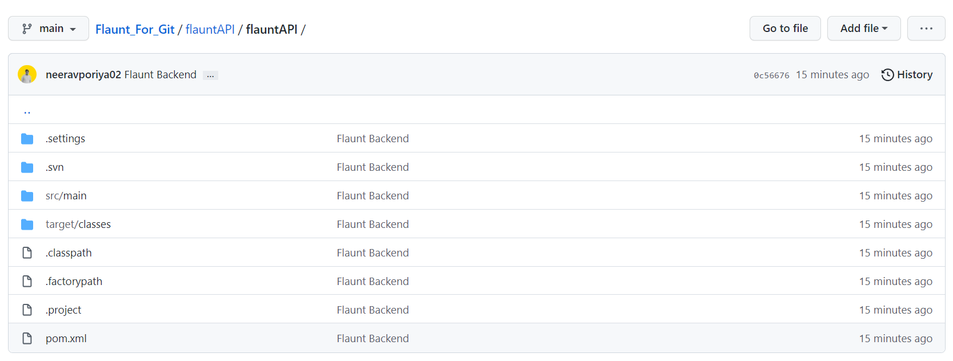
Flaunt Web Applications Backend Structure
We have used Java Springboot for backend structure, where we will be having API’s that interact with the database and do the validation and authentication.

Slide 14
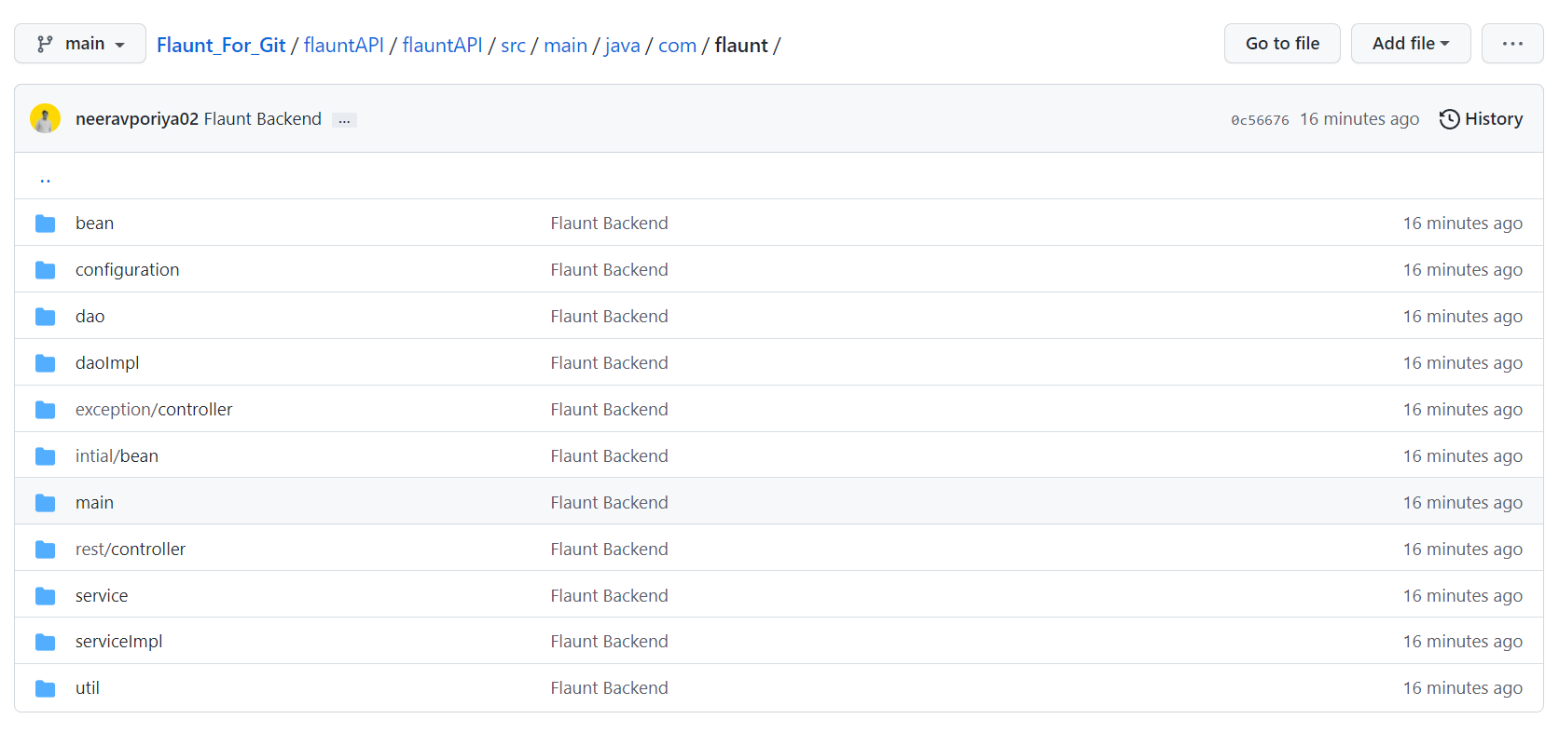
Flaunt Web Applications Backend Structure

Slide 15
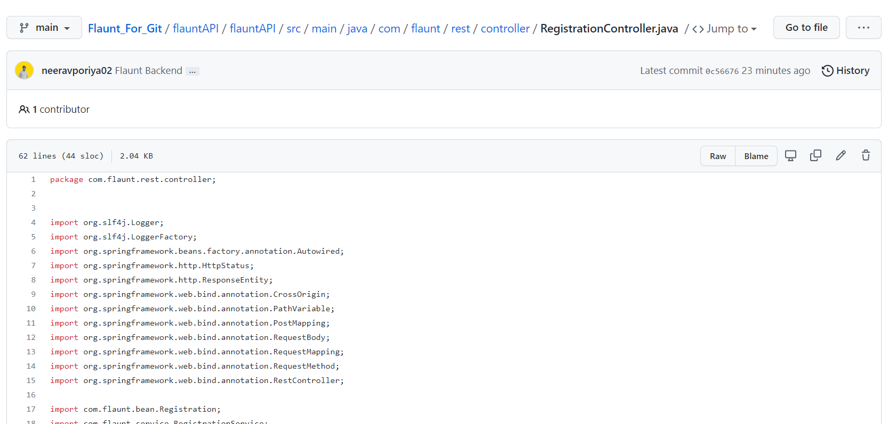
Controller
We will be creating different controllers for different section of the pages.
Here we can see Registration controller which handles customer singup, Profile handling with Authentication and Login.

Slide 16
Final Project Presentation Files

Slide 17
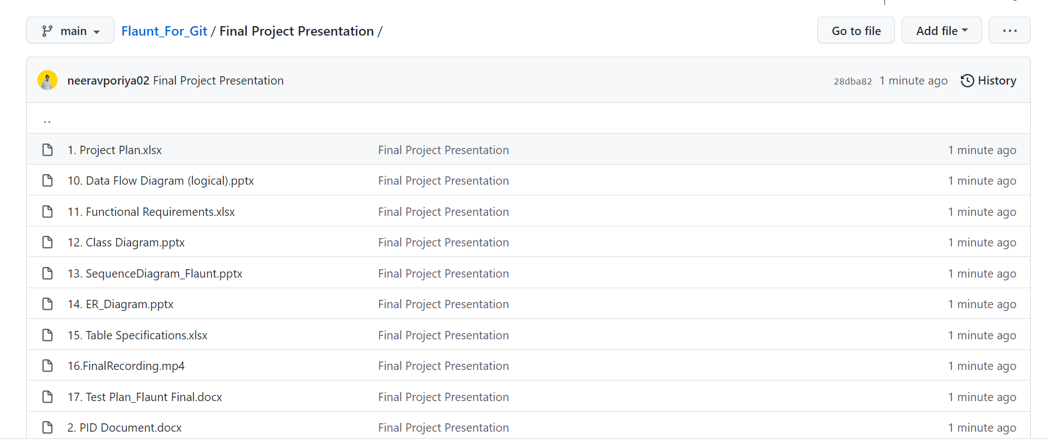
Flaunt Web Applications Final Project Presentation Structure

